Slide 1
Introduction of Linux OS
Linux is a operating system just like windows and mac.
Linux is open source and free operating system.
Linux was originally developed by linus Torvalds.
It is difficult to understand for new users.
Linux is gui based.
Linux started in 1991.
linux is everywhere it is in your phone’s, car’s, television etc.
Linux is most of the reliable, secure and worry free operating system.
Android is powerd by linux.
Linux latest version 5.6 is released in march 2020.

Slide 2
Components of linux system
Kernel : it is core part of linux .it is responsible for all major activities of linux. It is Heart of the Linux.
System library : this is special function and program. This system utilities accesses kernel’s features.
System utility : It is responsible to do specialized, individuals level task.

Slide 3
Features of linux
Portable
Open source
Multi-user
multiprogramming
Security

Slide 4
Distributions of linux
Ubuntu
Linux mint
Kali linux
Debian
fedora

Slide 5
Advantages
It is free
No anti-virus software needed
It’s speed and stability
Text editors
No reboot needed
Less disk space needed

Slide 6
disadvantages
No games
It is not easy to understand for beginners
Software alternative
Learning curve

Slide 7
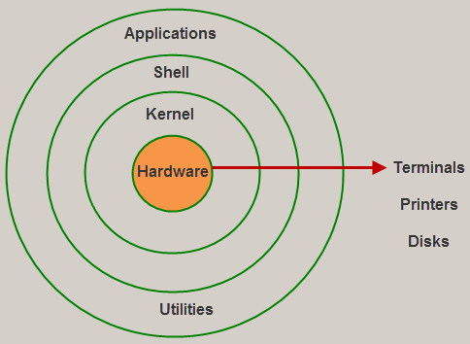
Architecture of linux

Slide 8
Thank you

